Slide 1
INT6005CEM BCSCUN CS1
Lau En Sin (15731047)
Arief bin Abdul Latib (15730888)
Bryan Yeoh Seng Sheng (15730936)
Hsia Hao Ze (15730992)
Khor Cojean (15731014)
Notes:
Change title

Slide 2
NECESSARY LINKS
GITHUB LINK
USER MANUAL
Original System GitHub Link
https://github.com/m-2199015/Online-Computer-Store.git
Enhanced System GitHub Link
https://github.com/Ensin2004/INT6005CEM_group_assignment_G23.git
https://github.com/Ensin2004/INT6005CEM_group_assignment_G23/tree/main/User%20Manual
Notes:
this

Slide 3
TABLE OF CONTENTS
01
02
03
04
05
SYSTEM OVERVIEW
SECURITY ANALYSIS
SECURITY IMPLEMENTATION
DISCUSSION
SUMMARY

Slide 4
01.
SYSTEM OVERVIEW

Slide 5
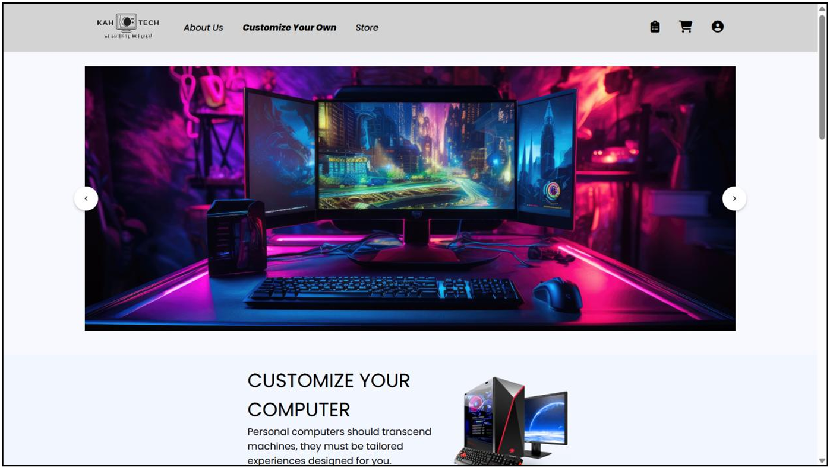
OUR SYSTEM
KAHTECH
User roles
Online computer store paltform for customers in to browse PC components, and place order.
User and Admin
Features
Ordering & Admin
Explore accessories, view product details and customize PC builds
Users can order with TNG e-Wallet or COD, Admins manage products, stock orders and reports
Notes:
this

Slide 6
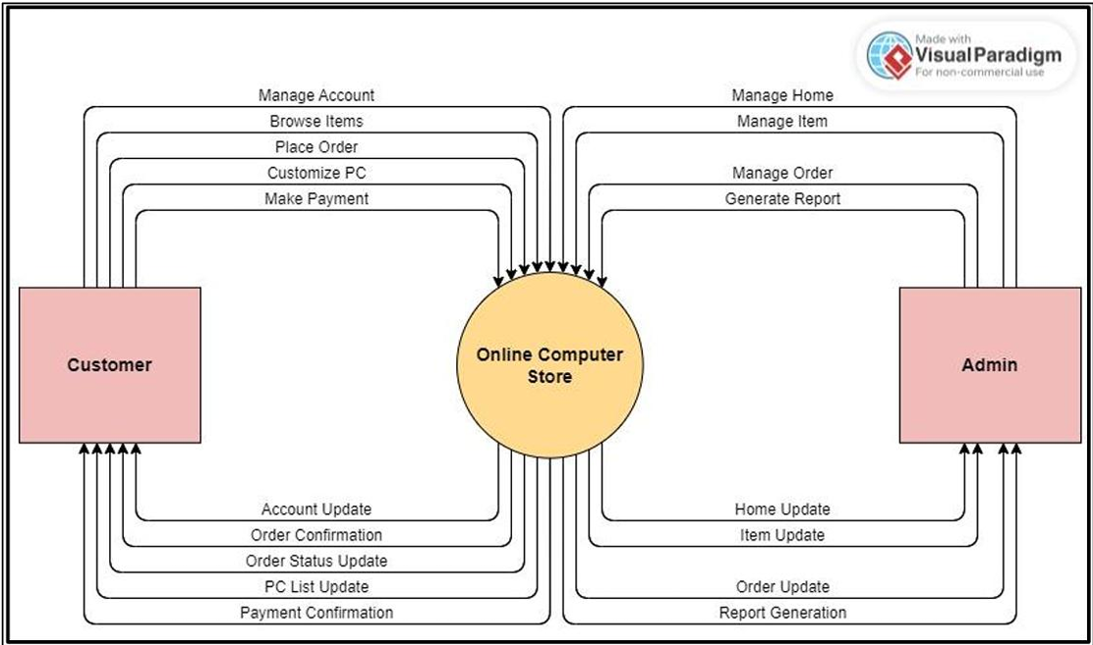
SYSTEM FUNCTIONALITIES

Slide 7
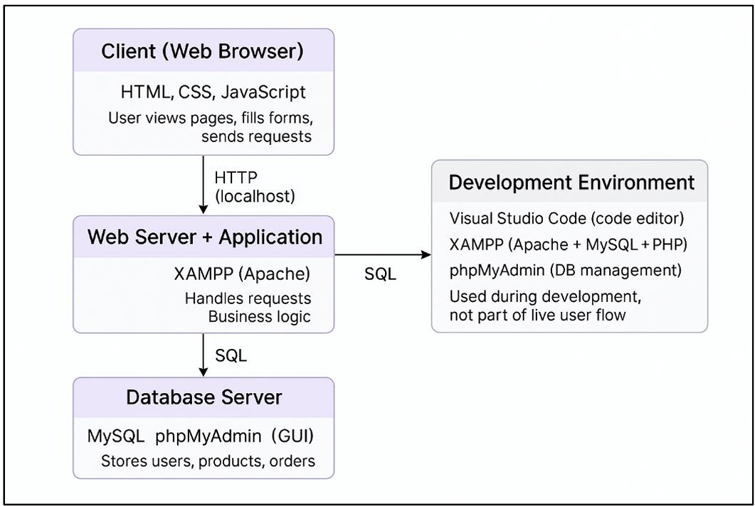
SYSTEM ARCHITECTURE

Slide 8
02.
SYSTEM ANALYSIS

Slide 9
SYSTEM ANALYSIS
01
03
02
Authentication
Password Security
Lack of login rate limiting, super admin and forgot password features.
Lack of strong password and password hashing implementation.
04
Email Account Handling
Data Privacy & User Education
Lack of email verification and backup email implementation.
Lack of data privacy policy and user education.

Slide 10
SYSTEM ANALYSIS
05
07
06
Session Management
Audit Logging
Lack of session timeout, protection against session fixation and CSRF attacks.
Lack of audit logging feature.
08
Error Handling
Input Validation & Cleaning
Lack of page and system error handling.
Lack of input validation, auto-trim, whitespace check and length input limit.

Slide 11
SYSTEM ANALYSIS
09
11
10
SQL Injection
Cross-Site Scripting (XSS)
Lack of protection against error-based, union-based and blind SQL injection.
Lack of protection against reflected, stored and DOM-based XSS.
12
Cryptography
Secure Cookies
Lack of protection against data-in-transit and data-at-rest.
Lack of secure cookies implementation.

Slide 12
SYSTEM ANALYSIS
13
Digital Certificate
Lack of digital certificate deployment.

Slide 13
03.
SYSTEM IMPLEMENTATION

Slide 14
03.
SYSTEM IMPLEMENTATION (1. AUTHENTICATION)

Slide 15
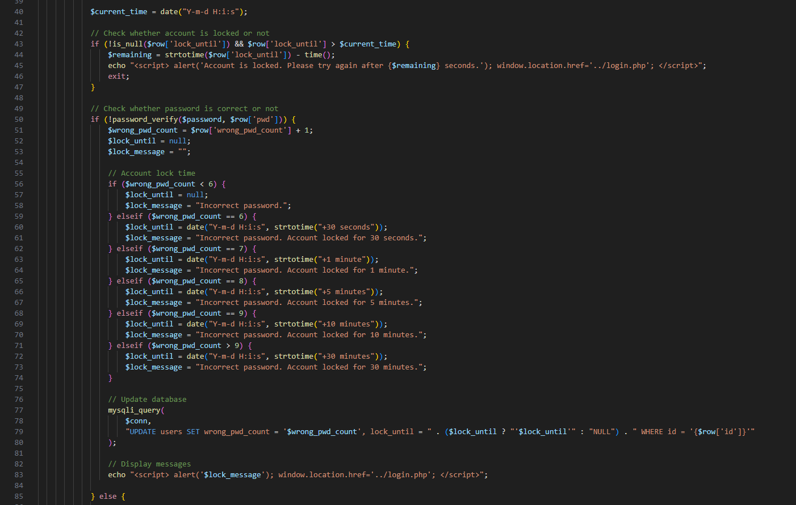
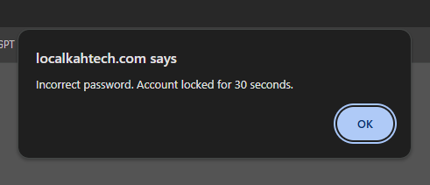
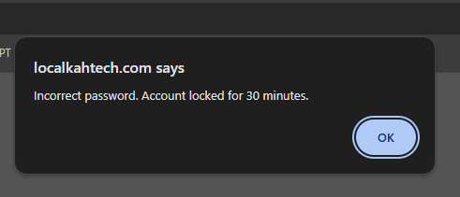
Login Rate Limiting
Protect the system from brute-force and automated password-guessing attacks.

Slide 16
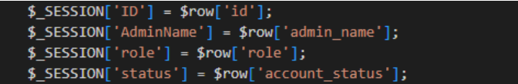
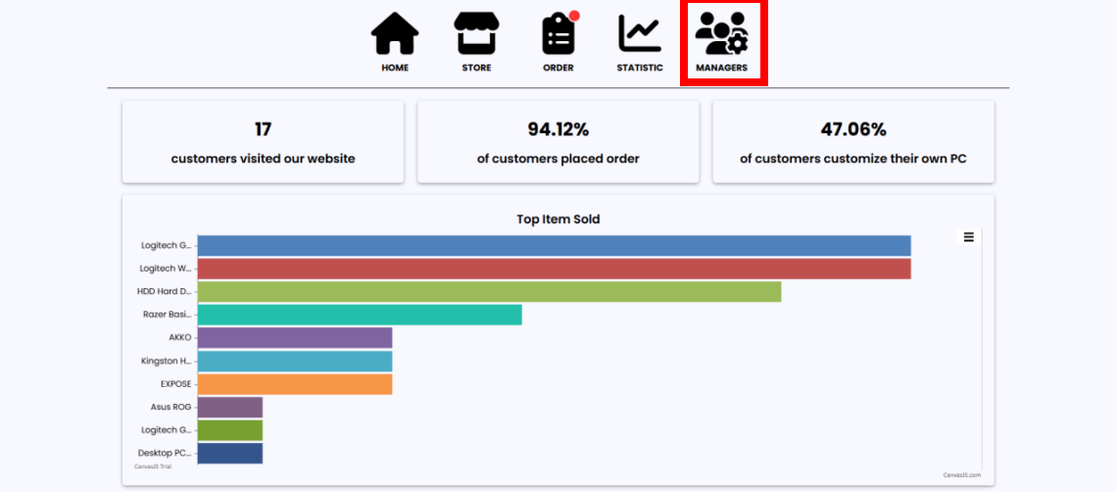
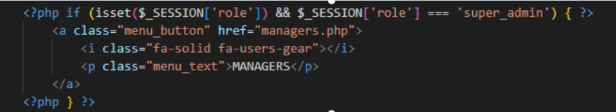
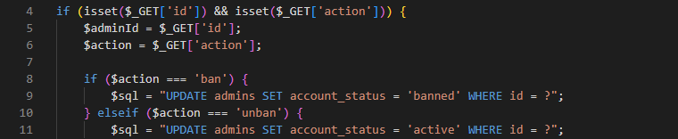

Super Admin Role Setup
Role Based Access Control, managers do not have access to “managers” page, only admins are able to access it and manage managers.
Notes:
this

Slide 17

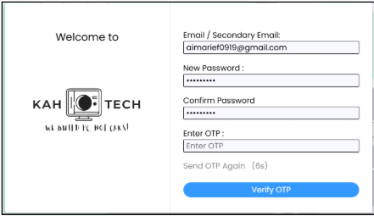

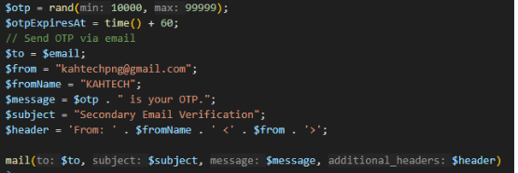
Forgot Password Mechanism
Avoid permanent lock out when user forget the password, also prevent social engineering risk especially for those who store their login information on another platform or physically.

Slide 18
03.
SYSTEM IMPLEMENTATION (2. PASSWORD SECURITY)

Slide 19
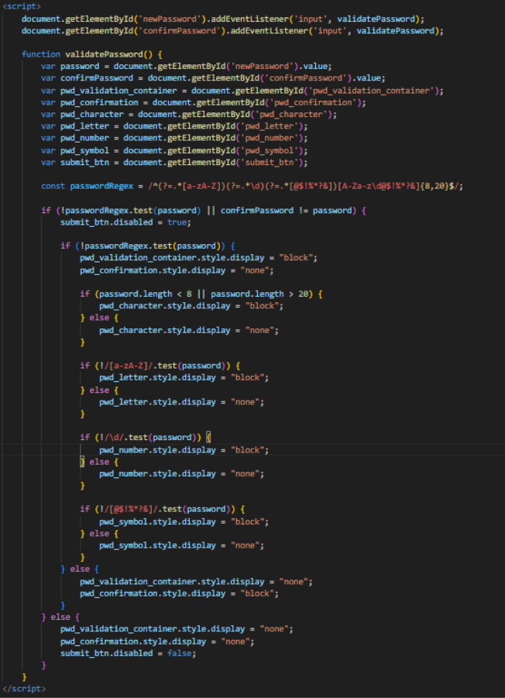
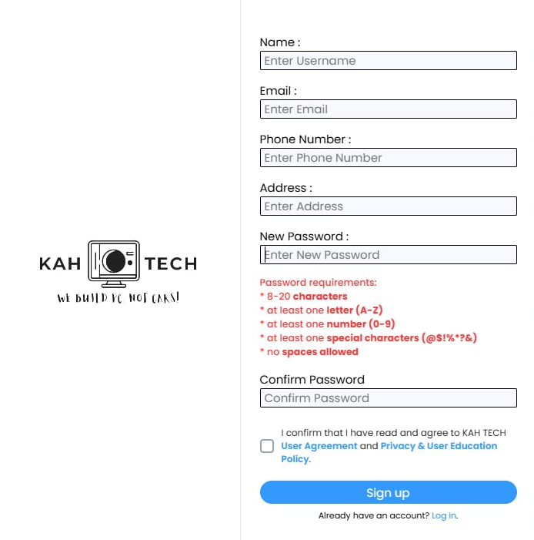
Strong Password Validation
Enforced strong password validation, requiring 8-20 characters, one letter, one number, one special character and no spaces allowed.
Notes:
this

Slide 20
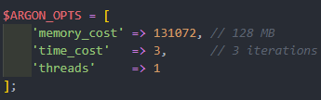


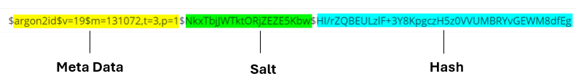
Password Hashing & Salting
Converts passwords into irreversible hashes with unique salts instead of plaintext so stolen database data cannot reveal the original passwords

Slide 21
03.
SYSTEM IMPLEMENTATION (3. MFA & EMAIL CONTROL)

Slide 22
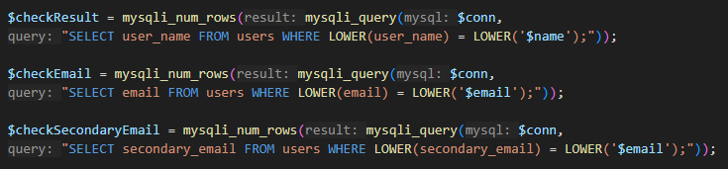
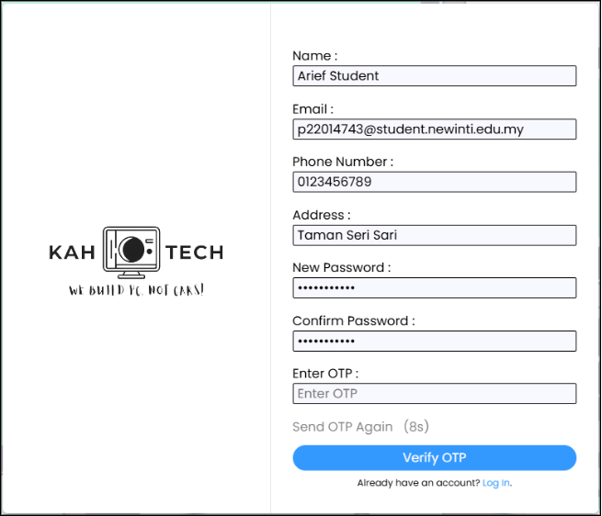
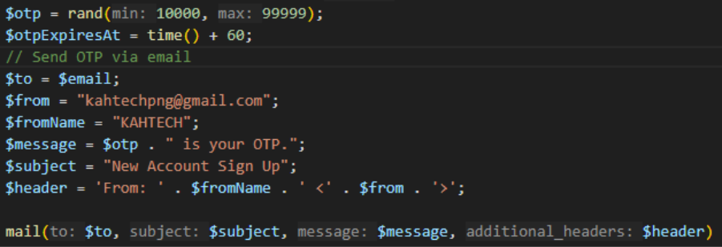
Email Verification
Username and email addresses that are used cannot be used again and OTP will be sent for verification so one email can only sign up for one time to prevent any spamming of bot accounts which may lead to DDOS attack.

Slide 23
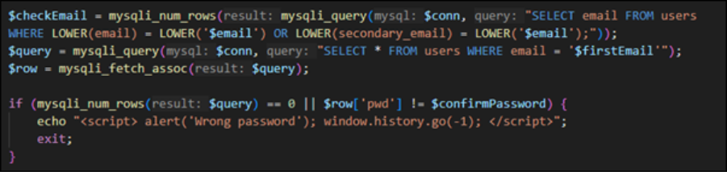
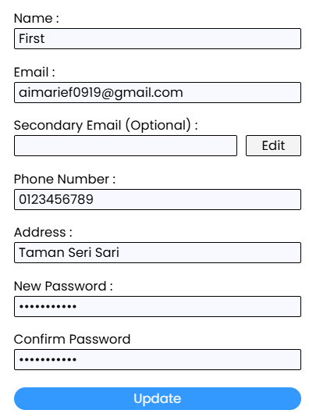
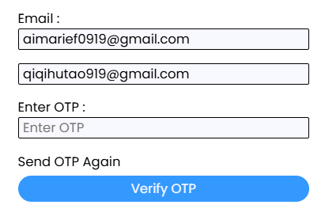

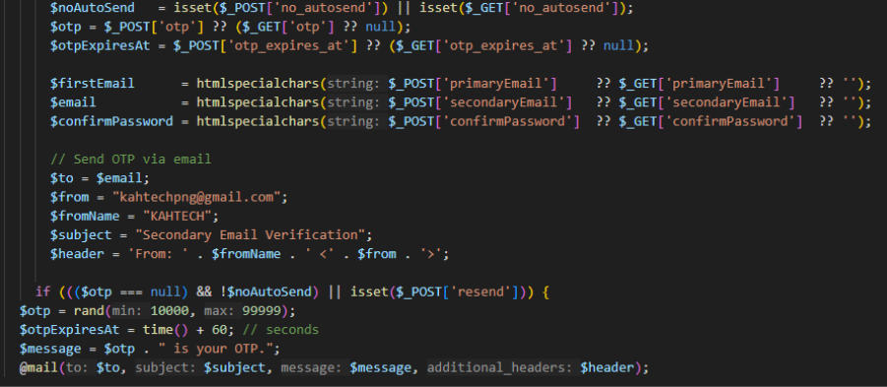
Backup Email / Recovery with MFA
If the main email has problems, the backup allows users to have a second way to prove ownership which prevent users from being permanently unavailable from the system.

Slide 24
03.
SYSTEM IMPLEMENTATION (4. DATA PRIVACY & USER EDUCATION)

Slide 25
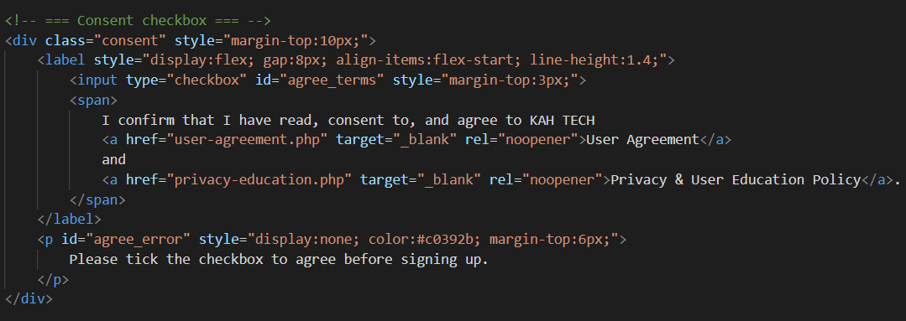
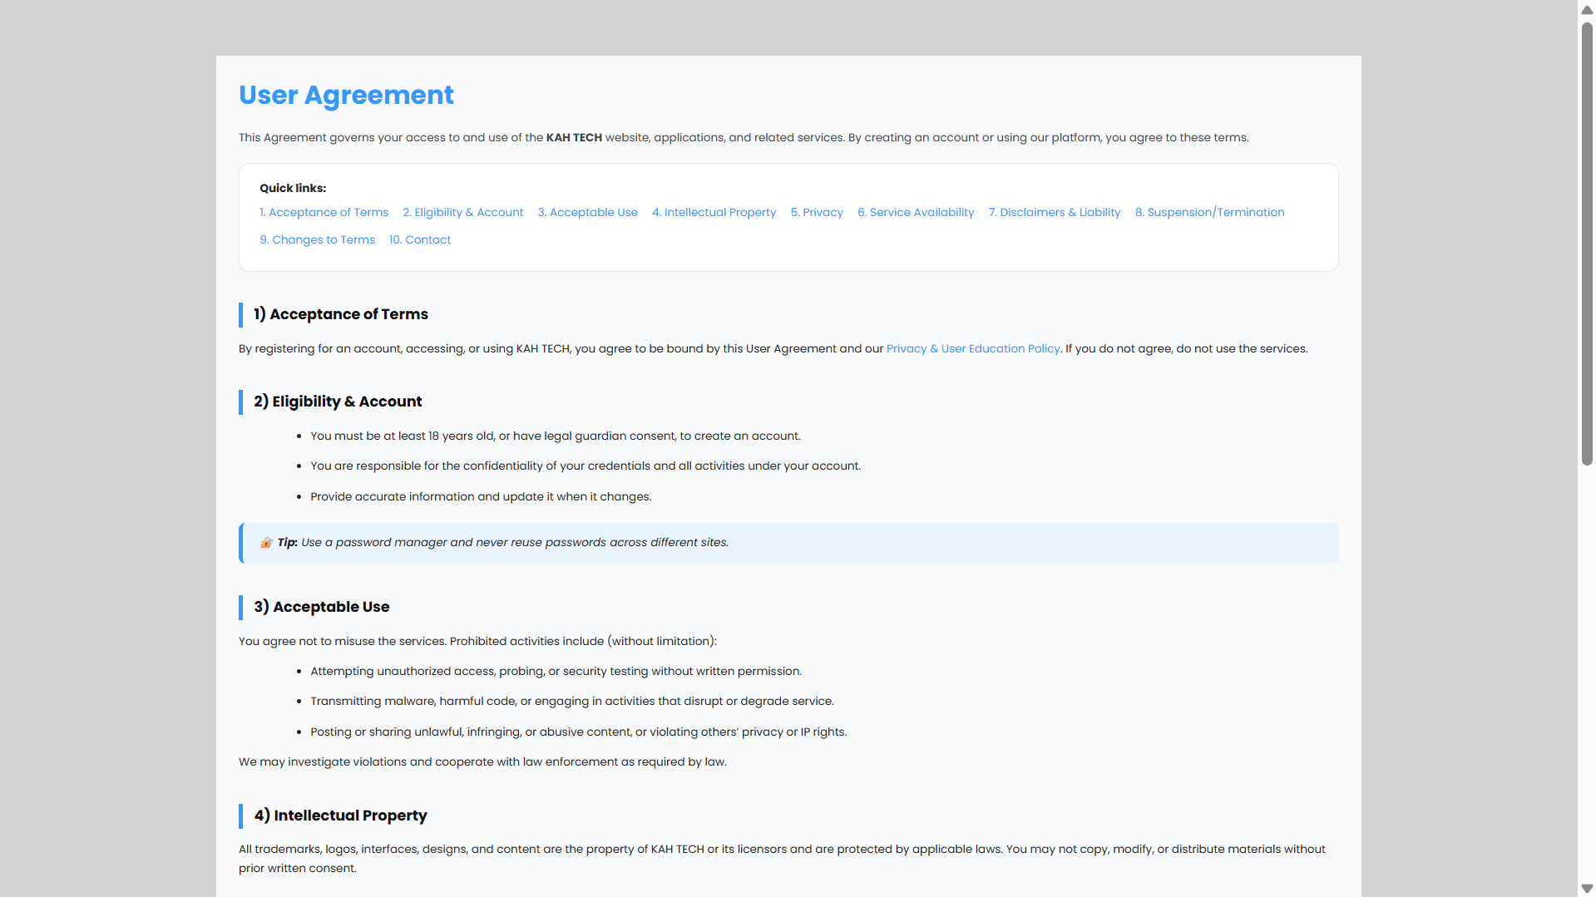
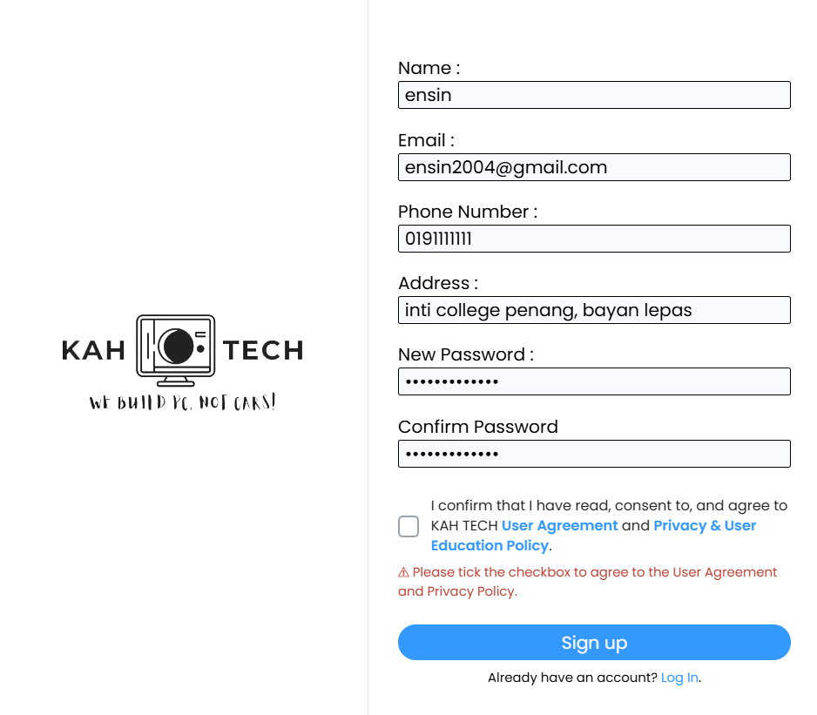
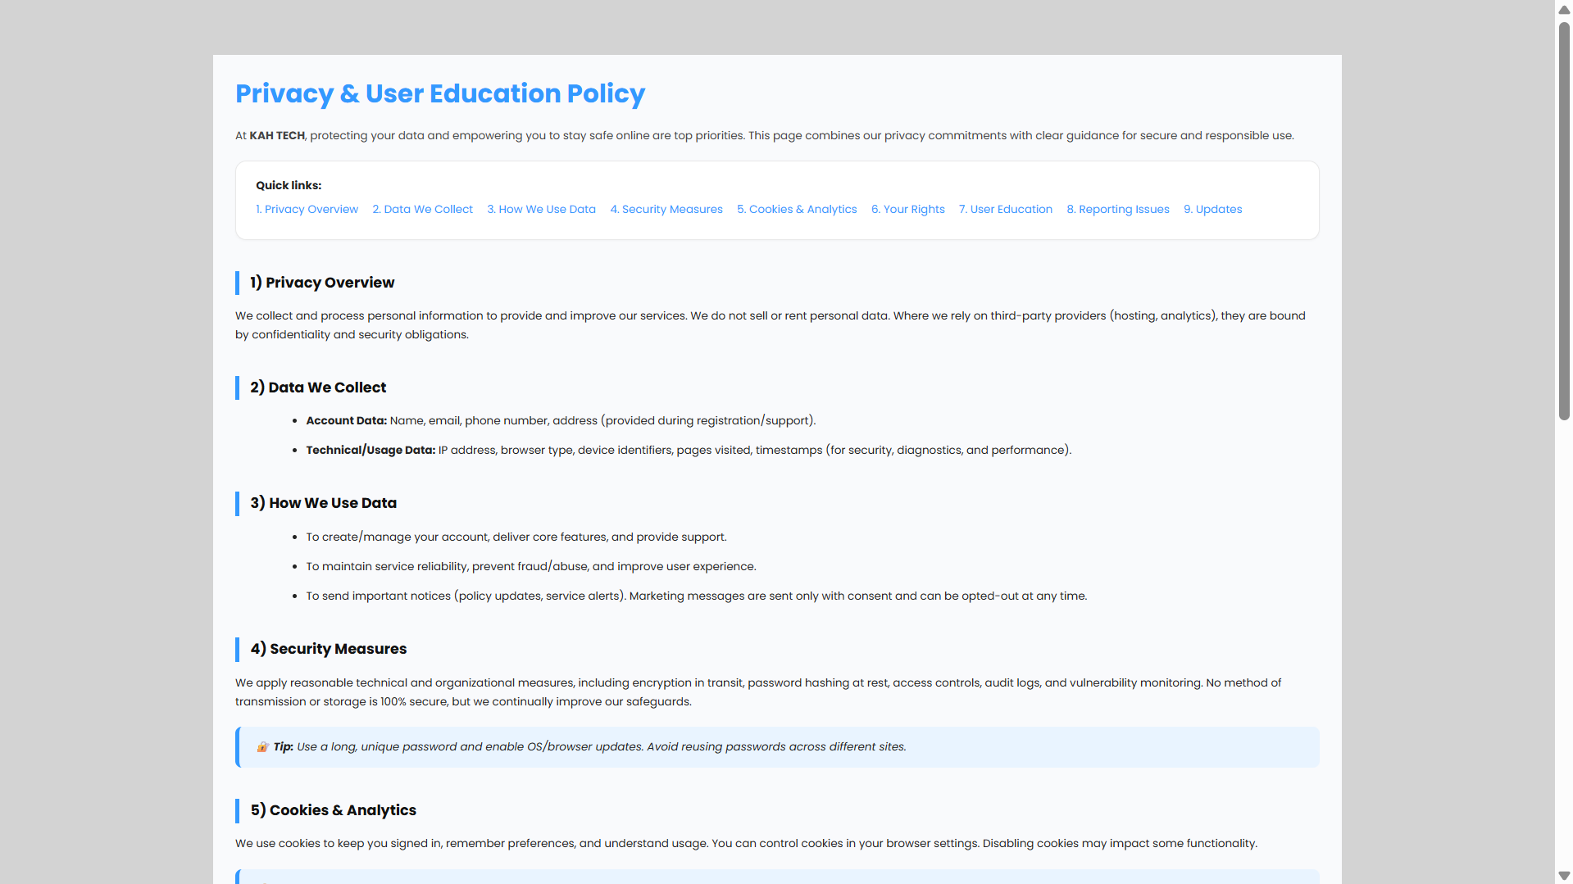
Data Privacy & User Education
User agreement
Privacy & user education
These controls ensure every user clearly understands the terms, privacy practices and safety guidelines before creating an account
Notes:
ensin

Slide 26
03.
SYSTEM IMPLEMENTATION (5. SESSION MANAGEMENT & CSRF PROTECTION)

Slide 27
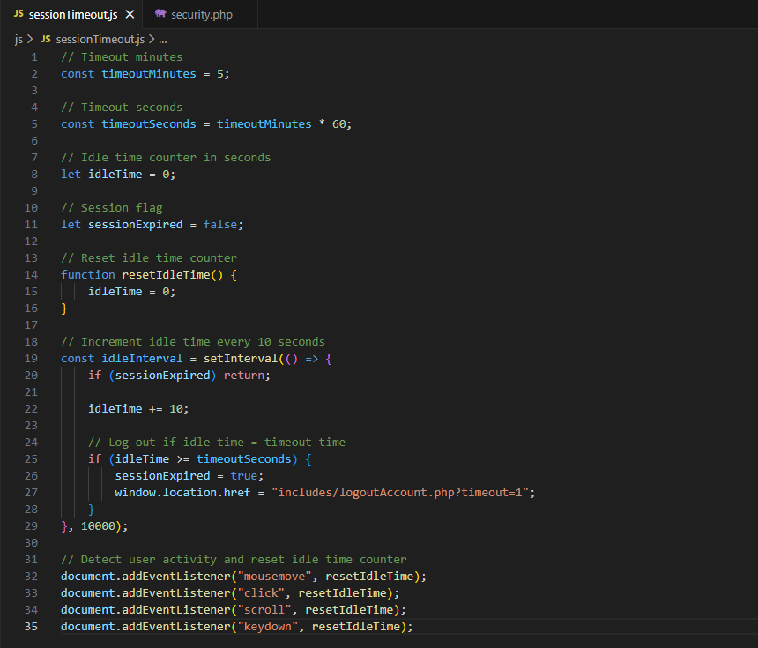
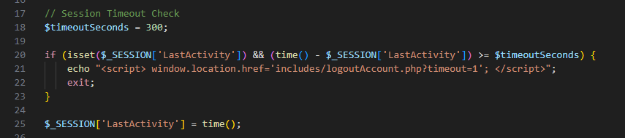
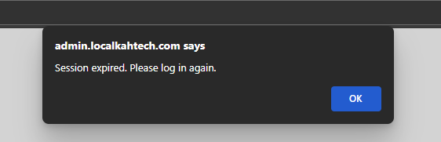
Session Timeout
Protect the system from risks associated with unattended devices, shared computers and session misuse.

Slide 28
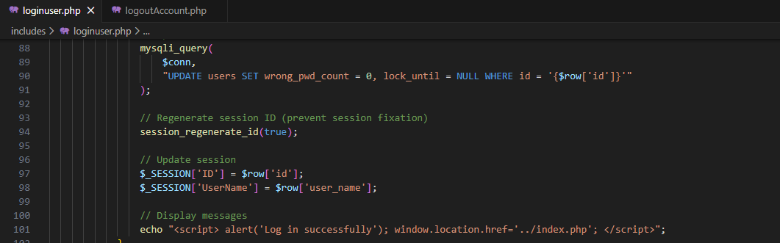
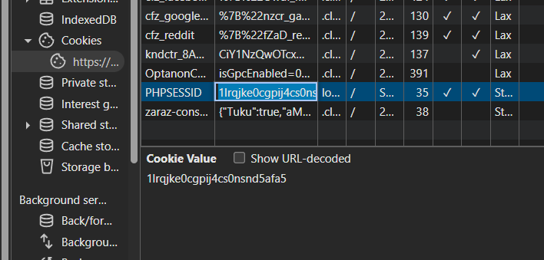
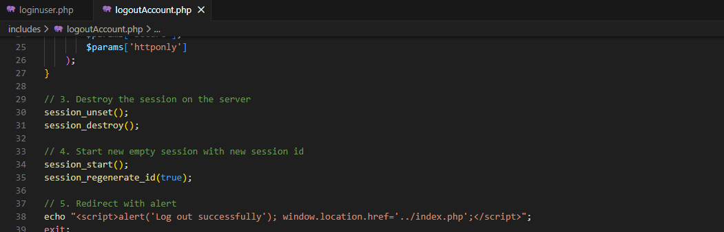
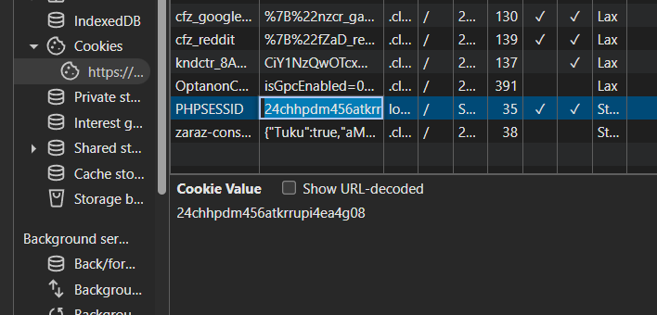
Session Regeneration
Before login
After login
Attackers can no longer reuse or fix the session ID on the victim’s device, mitigate the risk of session fixation attacks.

Slide 29
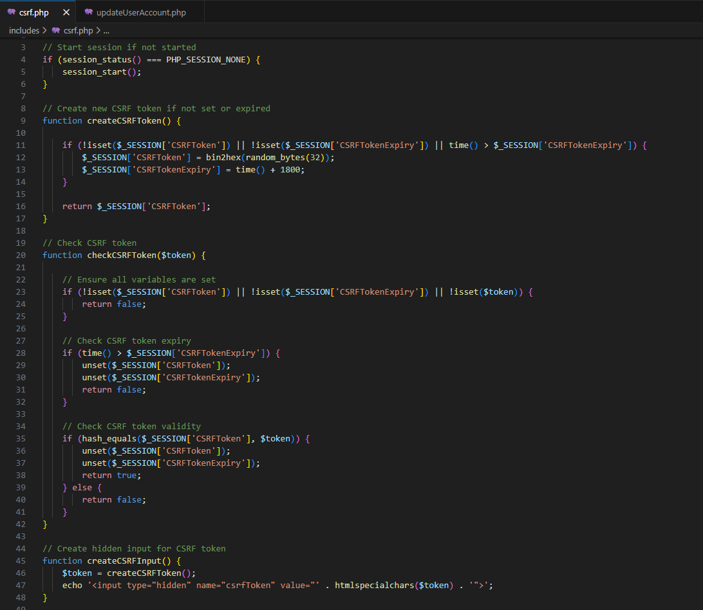
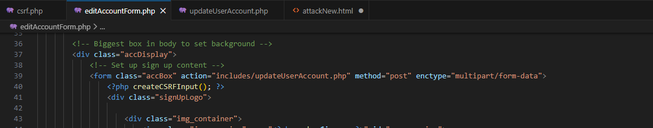
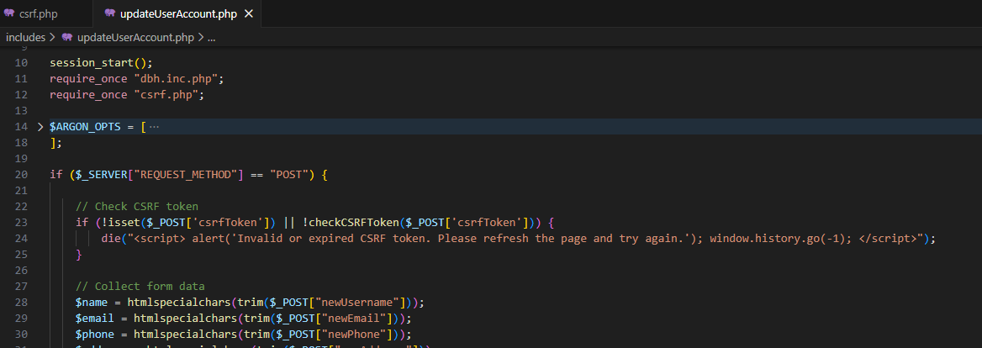
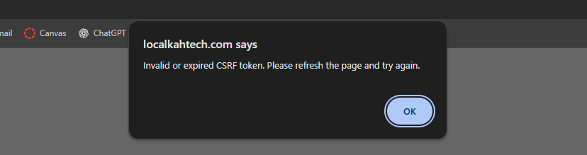
CSRF Token Implementation
CSRF token prevents request from unauthorized websites to be executed.

Slide 30
03.
SYSTEM IMPLEMENTATION (6. LOGGING & MONITORING)

Slide 31
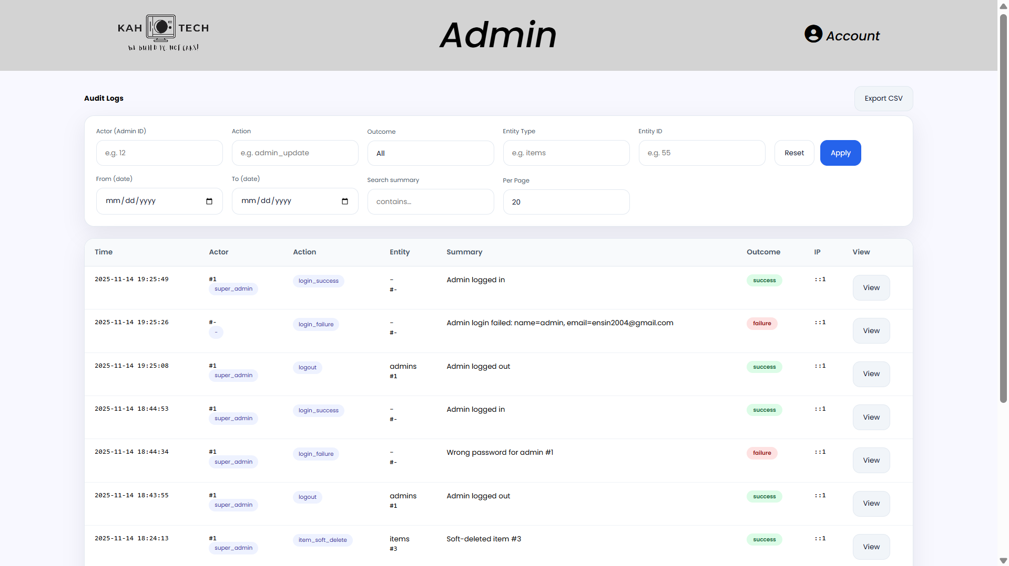
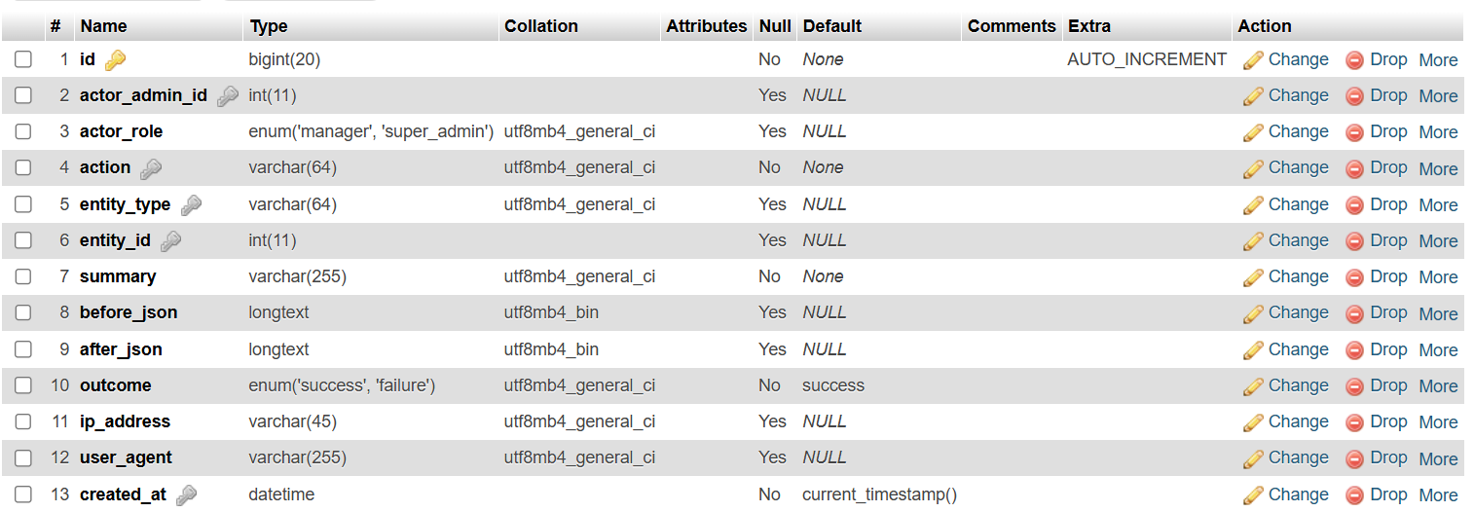
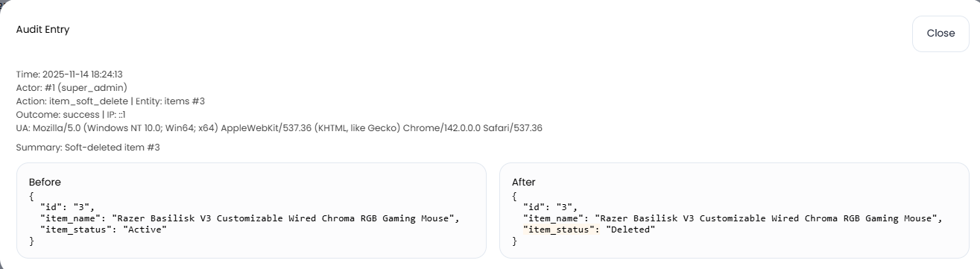
Logging & Monitoring
Strengthens accountability, supports incident investigation and ensures all critical actions are fully traceable.
Notes:
ensin

Slide 32
03.
SYSTEM IMPLEMENTATION (7. ERROR HANDLING)

Slide 33
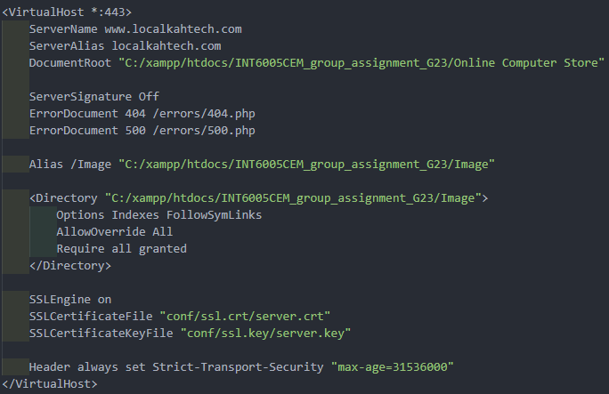
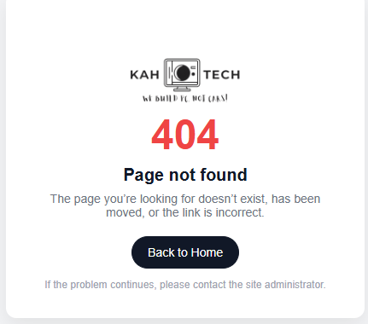
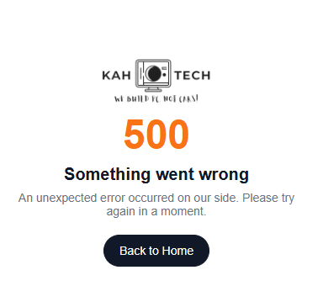
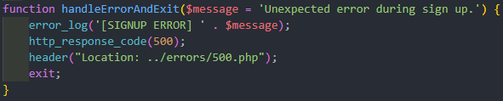
Unified Error Page
Provides a single safe fallback screen so unexpected failures show controlled messages without exposing system details.

Slide 34
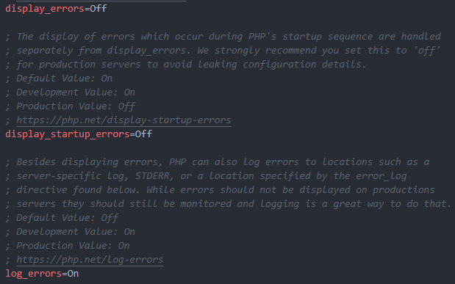
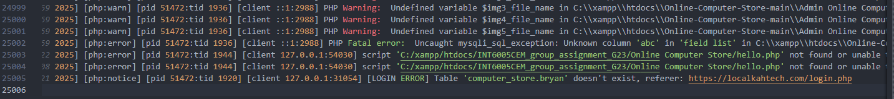
Suppress Sensitive Details
Hides internal system information so errors reveal only safe messages, preventing attackers from learning anything useful for exploitation

Slide 35
03.
SYSTEM IMPLEMENTATION (8. INPUT VALIDATION & CLEANING)

Slide 36
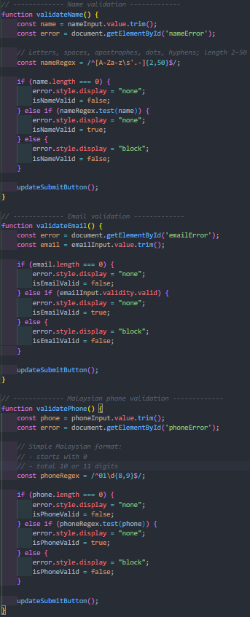
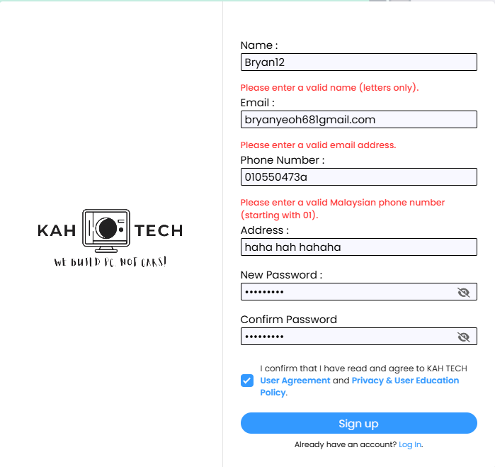
Input Validation
Input validation checks whether submitted data follows the required rules so only safe, expected values enter the system, blocking harmful or invalid inputs.

Slide 37
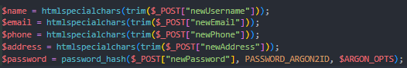


Trim & Whitespace Checks
Trim and whitespace checks remove extra spaces and hidden characters so the system processes clean, accurate input and blocks sneaky manipulation.

Slide 38



Input Limiting
Input limiting restricts data size and format so only safe, valid inputs are accepted, blocking malicious or oversized submissions.

Slide 39


Input Limiting
User Sign Up Form Limit
Admin Add Item Form Limit

Slide 40
03.
SYSTEM IMPLEMENTATION (9. SQL INJECTION PREVENTION)

Slide 41





SQL Prevention
Input Sanitization
Escaping Special Characters
Parameterized Queries
Together, these layered controls ensure all user inputs are safely handled and malicious SQL commands are fully prevented from reaching or manipulating the database

Slide 42




SQL Prevention
Error based SQL Injection
Union based SQL Injection
Blind SQLi Injection (Boolean)
Blind SQLi Injection (Time)

Slide 43
03.
SYSTEM IMPLEMENTATION (10. XSS MITIGATION)

Slide 44




XSS Mitigation
Ensure that any malicious input is safely neutralised and displayed as harmless text, preventing scripts from ever running in the browser

Slide 45



XSS Mitigation
Script Tag
Attribute Injection
Image Error Handler
JavaScript URL

Slide 46
03.
SYSTEM IMPLEMENTATION (11. DIGITAL CERTIFICATE DEPLOYMENT)

Slide 47



Digital Certificate Deployment
Provides authenticated and encrypted communication, significantly improving overall data confidentiality and integrity.

Slide 48
03.
SYSTEM IMPLEMENTATION (12. CRYPTOGRAPHY IMPLEMENTATION)

Slide 49



Data-in-Transit (HTTPS/ TLS1.3)
TLS 1.3 setup ensures all traffic fully encrypted and protected in transit, keeping sensitive data secure without needing extra application-level encryption.

Slide 50






Data-at-Rest (AES-256-GCM)
Before & After:
Encryption:
Key:

Slide 51


Data-at-Rest (AES-256-GCM)
Code-Based Verification Against Database Value
UI-Level Check
AES-256-GCM setup ensures sensitive database fields remain unreadable if leaked while still decrypting safely and accurately when the system needs them.

Slide 52
03.
SYSTEM IMPLEMENTATION (13. BROWSER COOKIE)

Slide 53


Browser Cookie Security
Browser cookies are configured with strict security settings to protect from theft, sniffing and CSRF attacks

Slide 54
04.
DISCUSSION

Slide 55
OWASP TOP 10 COVERAGE
ACHIEVED | PARTIALLY ACHIEVED | NOT APPLICABLE
A01 – Broken Access Control A02 – Cryptographic Failures A03 – Injection (SQLi) A05 – Security Misconfiguration A07 – Identification & Authentication Failures A09 – Security Logging & Monitoring Failures | A04 – Insecure Design A06 – Vulnerable & Outdated Components A08 – Software & Data Integrity Failures | A10 – Server-Side Request Forgery (SSRF)
Notes:
List only, no need explain

Slide 56
REMAINING VULNERABILITIES AFTER CONTROL
A01
A03
A02
Broken Access Control
Cryptographic Failures
New pages/APIs may skip role checks
Risk of exposing sensitive IDs in URLs
Fix: Follow consistent access control rules
AES/TLS depends on proper key storage
Require encryption and strict access to backups
Fix: Improve key handling & backup encryption
A04
Injection
Insecure Design
Legacy code may use unsafe SQL
Fix: Enforce prepared statements in code reviews
Controls exist but no formal threat modelling
Fix: Use simple design/threat checklist

Slide 57
REMAINING VULNERABILITIES AFTER CONTROL
A05
A07
A06
Security Misconfiguration
Vulnerable & Outdated Components
Configurations may drift during deployment
New servers may miss error pages or HSTS
Fix: Use deployment checklists to prevent drift
Libraries may become outdated silently
No automated dependency monitoring
Fix: Add automated scanning and patch cycles
A08
Identification & Authentication Failures
Software & Data Integrity Failures
Strong passwords + rate limiting exist
Still vulnerable to credential stuffing and no MFA for admins
Fix: Enforce MFA for admins; offer MFA for users
No code-signing or pipeline integrity checks
Fix: Harden DevOps pipeline and use signed releases

Slide 58
REMAINING VULNERABILITIES AFTER CONTROL
A09
A10
Security Logging & Monitoring Failures
SSRF
Logs not analysed centrally
Suspicious activity may be detected late
Fix: Centralize logs / SIEM
Not currently applicable
Future features (webhooks, URL fetchers) could introduce SSRF
Fix: Apply SSRF-safe design for URL-fetching features

Slide 59
FUTURE ENHANCEMENT
Automated Dependency Scanning
Full MFA for Admins
Secure SDLC & Checklists
Enable MFA for all admin login
Use TOTP + controlled recovery
Reduces password compromise
Track all libraries/component
Use Composer/NPM/Git scans
Catch CVEs before deployment
Use security checklists in reviews
Quick threat-modelling for major changes
Prevents new vulnerabilities
1
2
3
4
5
CSP & Browser Hardening
Centralized Logging & Alerts
Add CSP to block untrusted scripts
Set security headers (nosniff, DENY, referrer policy)
Mitigates XSS + clickjacking
Send app + server logs to SIEM/ELK
Dashboards + alerts for anomalies
Faster threat detection
Notes:
Replace num with icon if can, no need also nvm

Slide 60
05.
SUMMARY

Slide 61
SUMMARY
CONCLUSION
LEARNING OUTCOME ACHIEVED
System now addresses most OWASP Top 10 risks
Major OWASP risks addressed (SQLi, XSS, weak sessions, no TLS, plaintext passwords)
Implemented Argon2id, TLS 1.3, CSRF, secure cookies, logging & safer queries
Overall system now far more secure and closer to production-ready
Hands-on experience with SQLi, XSS, session abuse & crypto issues
Implemented real defenses: Argon2id, AES-GCM, TLS, CSRF, secure sessions
Improved risk prioritization (Likelihood × Severity)
Gained skills with Burp, Wireshark & dev tools
Notes:
this

Slide 62
THANK YOU

